Slide 1
Introduction & Overview
Cyber Security
Part II
Authentication & Authorization Summary

Slide 2
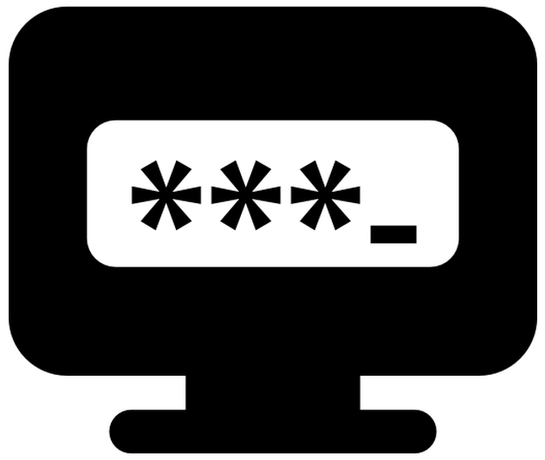
How passwords work: Creation
User enters a password first time (plain text)
System forces the password to
comply with complexity rules
Ideally password should be transmitted to the system over encrypted channels

Slide 3
How passwords work: Storage
User entered password is hashed.
Algorithms used:
  Linux: MD5, SHA 256, Blowfish etc.
  Windows: LM, NTLM hashing
  Recommended: Bcrypt, Scrypt, PBKDF2

Slide 4
How passwords work: Comparison
User enters a password to authenticate. System takes the password and hashes it
Compares the hash of what the user entered against the hash stored in the password file
If they match, allows access. Else declines.
(Watch out for error messages!)

Slide 5

Password Cracking
Time needed to crack: understanding password strength.
Mechanisms:
  Online Brute Forcing
  Offline Cracking: Via the obtained password hashes (John the ripper)
  A different approach: using pre-
computed hashes (Rainbow tables)
Prevention: account lockout, captcha, two factor, salting, complex passwords

Slide 6

Authorization
Authorization is a mechanism of verifying that a particular user is allowed to perform an action that user is attempting
Does subject S have right R for object O
  Subject: various users
  Rights: Read, Write, Execute
  Objects: Files, programs etc.
In real world, this is often done as Role Based Access Control (RBAC). Various roles defined, users assigned to those roles, rights granted accordingly

Slide 7
Introduction & Overview
Cyber Security
Part III
Importance of Physical Security for Cyber Security

Slide 8
Why Physical Security ?
Physical security is often overlooked -- and its importance underestimated -- in favor of more technical threats such as hacking, malware, and cyber espionage.
  However, breaches of physical security can be carried out with brute force and little or no technical knowledge on the part of an attacker.
Physical security has three important components:
  access control
  surveillance and
  testing

Slide 9

Physical Security Intro

Slide 10
Introduction
Physical security is the protection of personnel, hardware, software, networks and data from physical actions and events that could cause serious loss or damage to an enterprise, agency or institution.
This includes protection from fire, flood, natural disasters, burglary, theft, vandalism and terrorism

Slide 11
Physical Security Design
Physical security Design describes security measures that are designed to deny unauthorized access to facilities, equipment and resources, and to protect personnel and property from damage or harm (such as espionage, theft, or terrorist attacks).

Slide 12
Physical Security Protection
The physical measures & their associated procedures to safeguard & protect against:
    Damage
    Loss
    Theft
Implementing controls that discourage attackers by convincing them that the cost of attacking is greater than the value received from the attack.

Slide 13
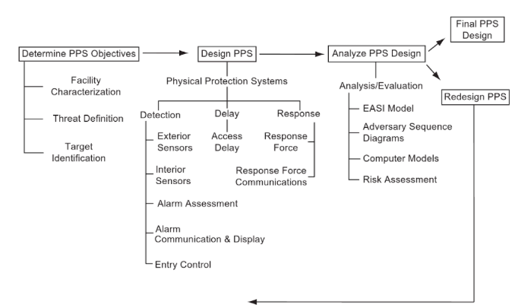
Physical Protection Systems Plan
Estimation of Adversary Sequence Interruption (EASI)

Slide 14
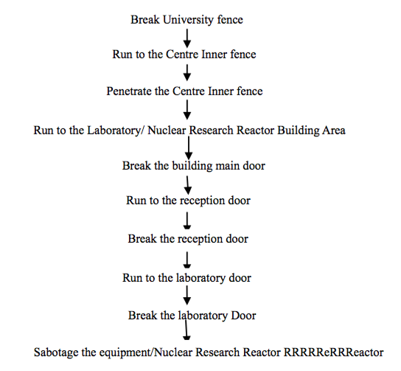
Physical Security Destruction plan

Slide 15
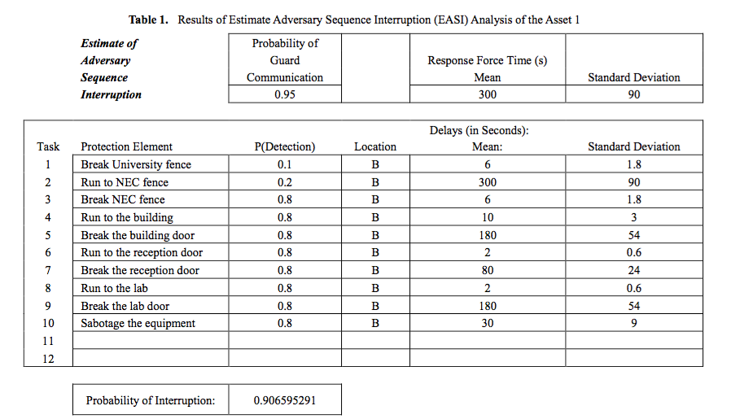
Sample EASI

Slide 16
PPS Plan Objectives
The Security Plan should be able to:
  Describe the threats, vulnerabilities, and countermeasures related to physically protecting the enterprise’s sensitive information assets.
  Identify the risk to facilities, data, media, equipment, support systems, and supplies as they relate to physical security.

Slide 17
Goals of Information Security
The common thread among good information security objectives is that they address all three core security principles.
Prevents unauthorized disclosure of systems and information.
_{Confidentiality}
Prevents unauthorized modification of systems and information.
_{Integrity}
Availability
Prevents disruption of service and productivity.
Notes:
The cornerstone of information Security.
In physical security, it is important to ensure all three elements are addressed.

Slide 18
Physical Security Requirements
  Life Safety
  Safety of people is the primary concern.
Notes:
Life safety is the primary goal. In an emergency situation, the organization must ensure the safety of personnel before the safety of the facility.

Slide 19
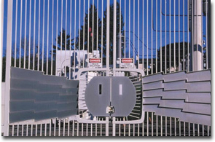
Goals of Physical Security
Deter
Delay
Detect
Assess
Respond
Physical security technology is comprised of barriers, entry and search controls, intrusion detection, alarm assessment, and testing and maintenance
Systems along with organizational practices and procedures – respond to unauthorized activity
Notes:
Physical security technology is comprised of barriers, entry and search controls, intrusion detection, alarm assessment, and testing and maintenance. Collectively this system, along with organizational practices and procedures, are intended to deter, delay, detect, assess, and appropriately respond to an unauthorized activity.

